Slide 1
Web Crawler for
Job Postings
Yingzhi Hao and Jason Kurian

Slide 2
Overview
A job posting web crawler that fetches job related info from web pages.
Users can send URL to the crawler to fetch certain pages.
And, the crawler runs periodically to crawl from a pool of URLs.
A search bar to query crawled results

Slide 3
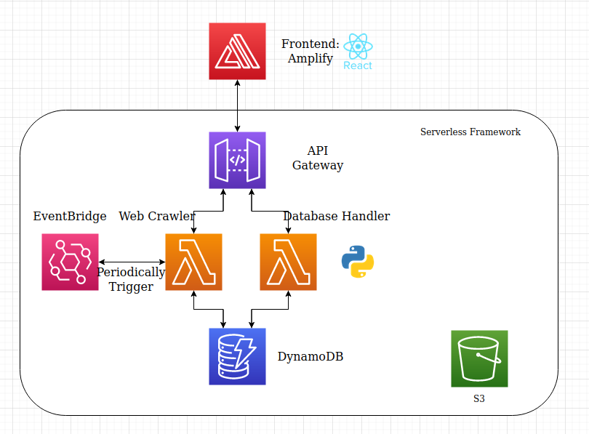
Architecture

Slide 4
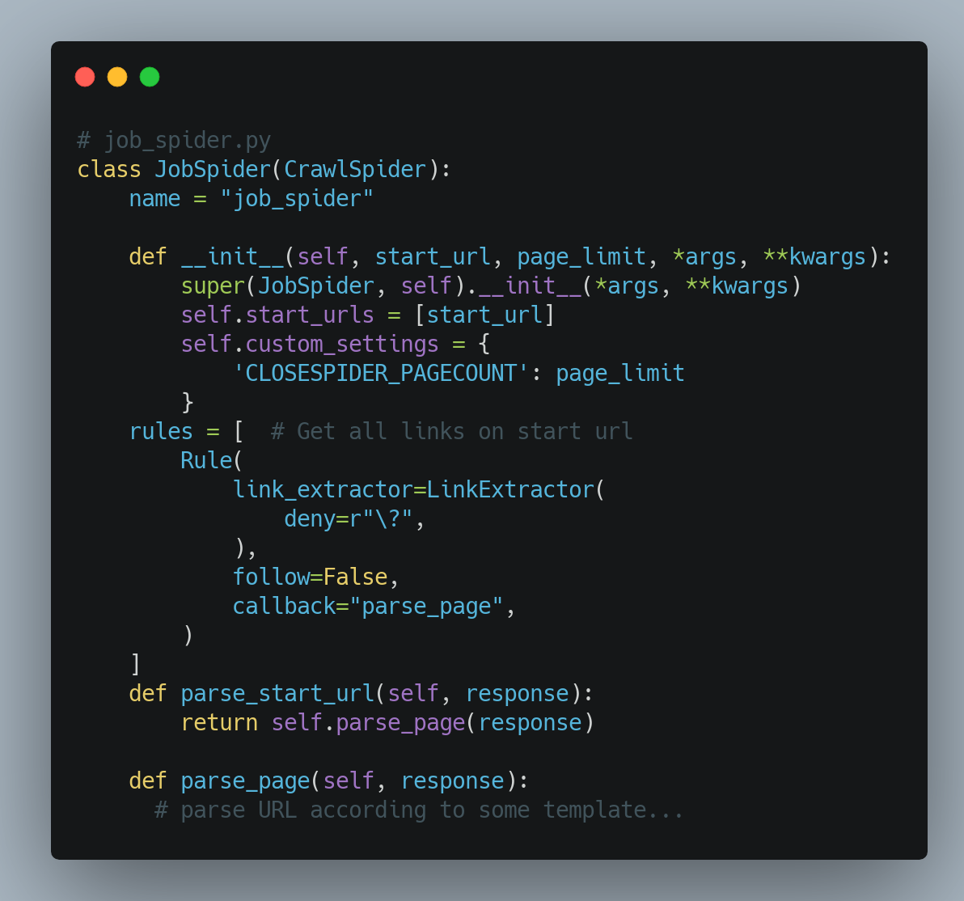
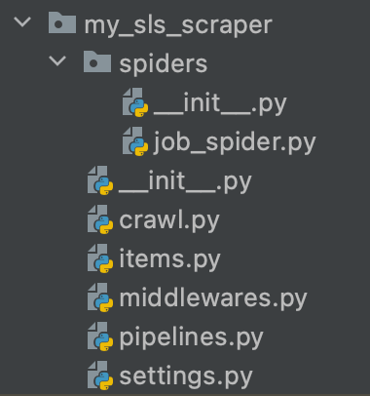
Scraping using Scrapy
Notes:
We use scrapy to actually scrape job postings from websites. It is an open-source web-crawling framework writing in python. Spiders are classes where we can define how exactly a website would be scraped. We define the initial start URLS to crawl, which is passed in from the post request, and then a link extractor gathers all the links on that page.

Slide 5
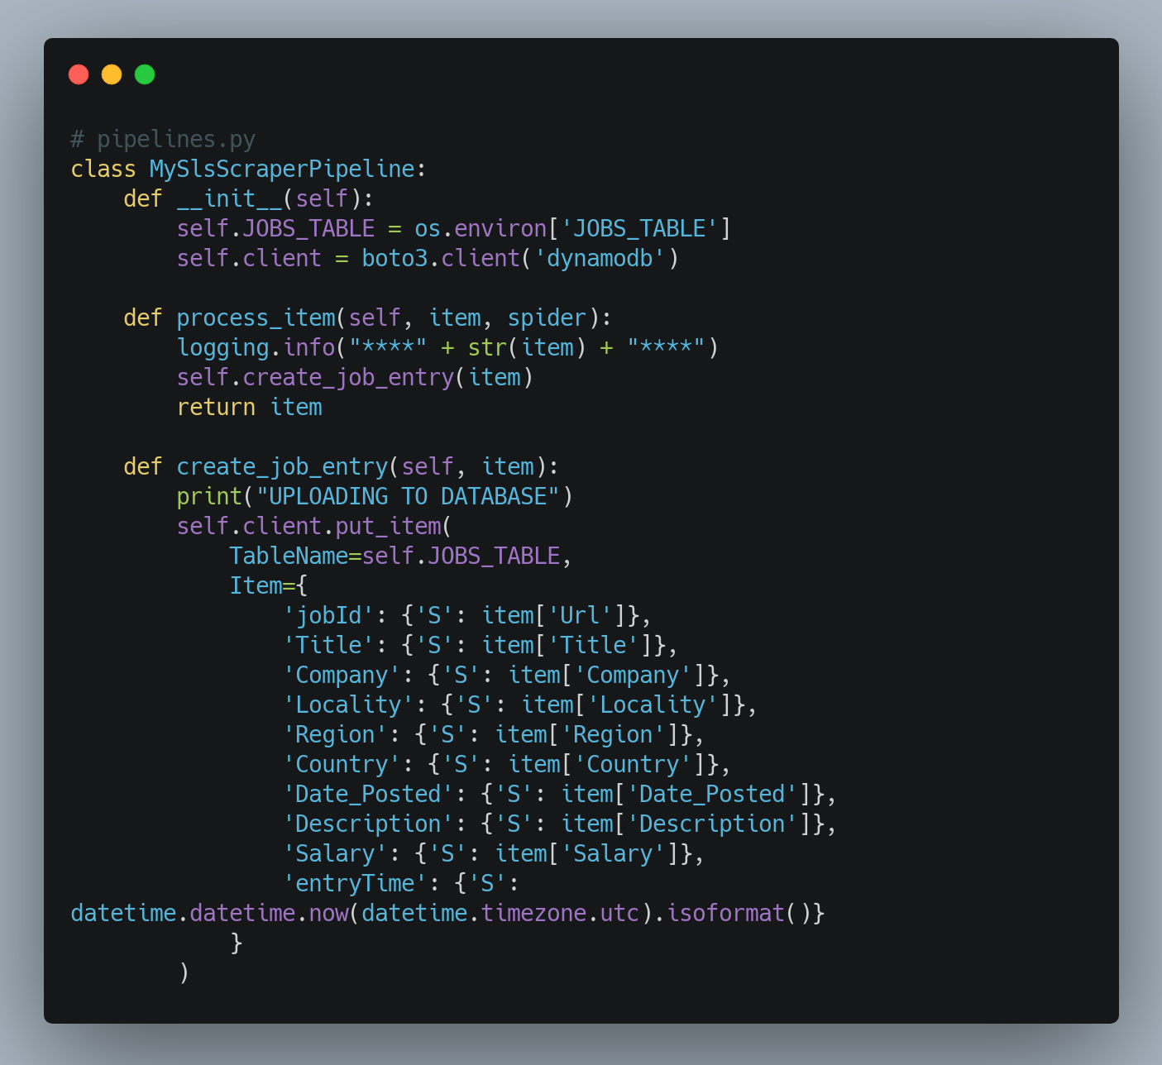
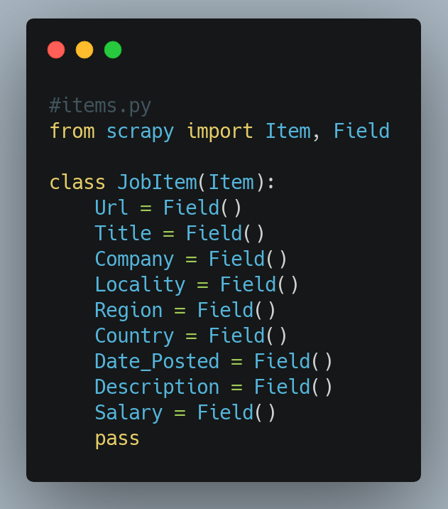
Scraping using Scrapy
Notes:
Items are containers used to collect the data that is scrapped from the websites.

Slide 6
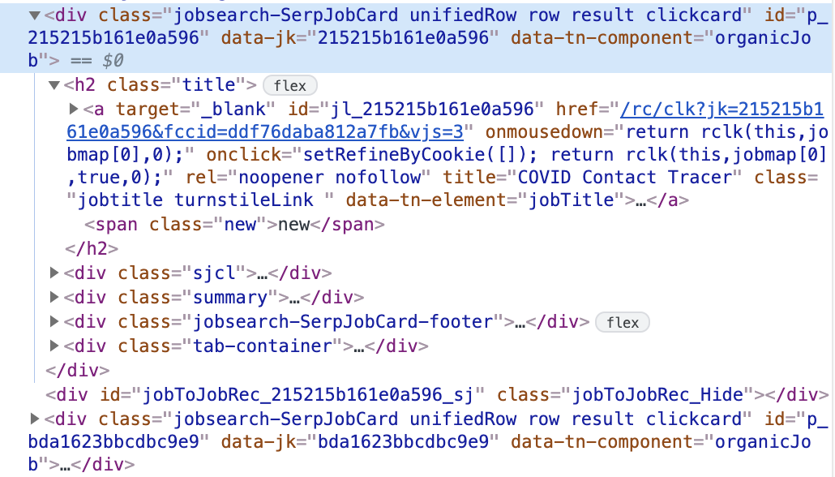
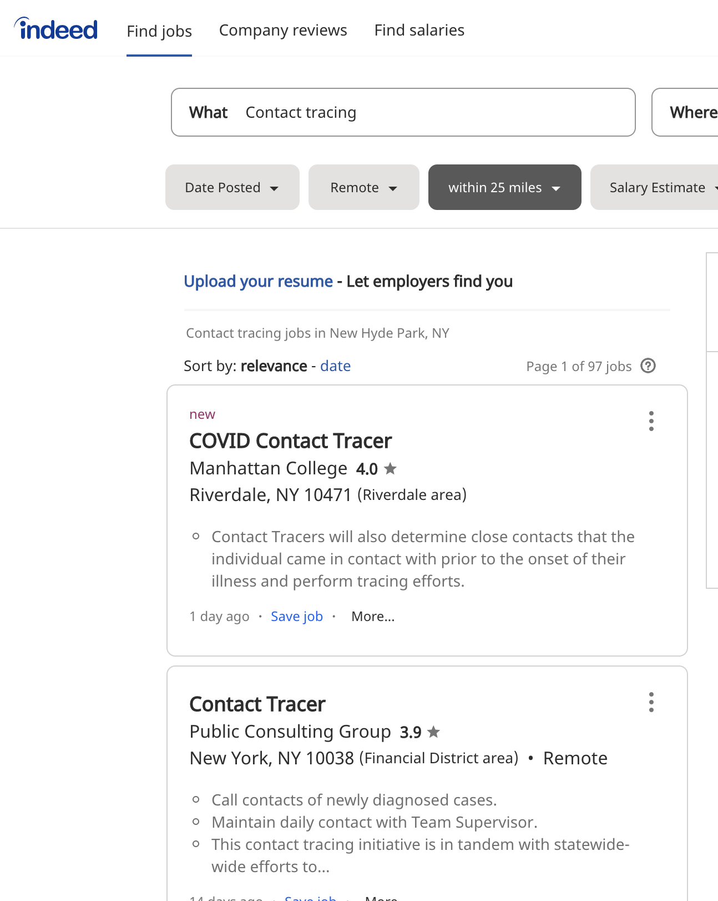
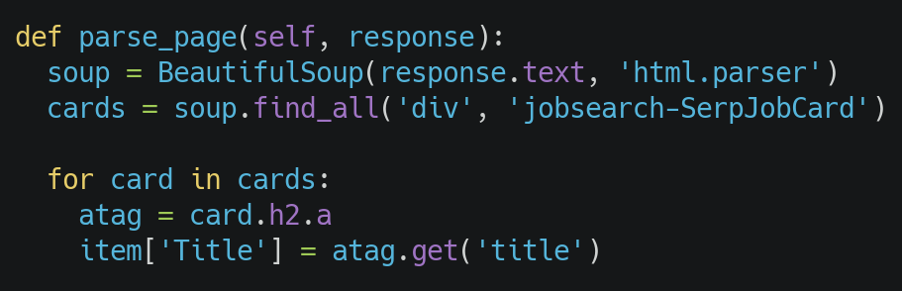
Parsing Job Sites

Slide 7
Demo

